Slide 1
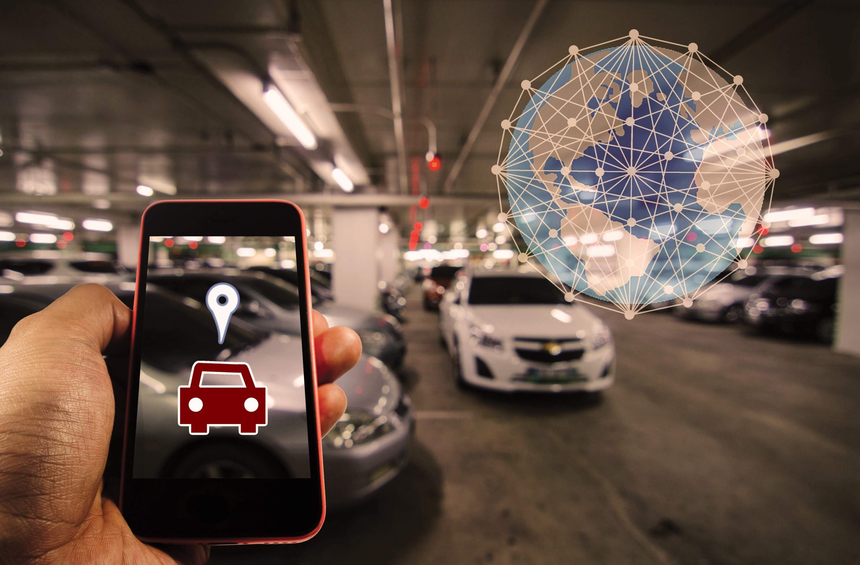
SPOT FINDER
ARRIVE STRESS FREE

Slide 2
Create an application that simplifies the process of finding and booking parking spaces in crowded cities.
SlideMake.com

Slide 3
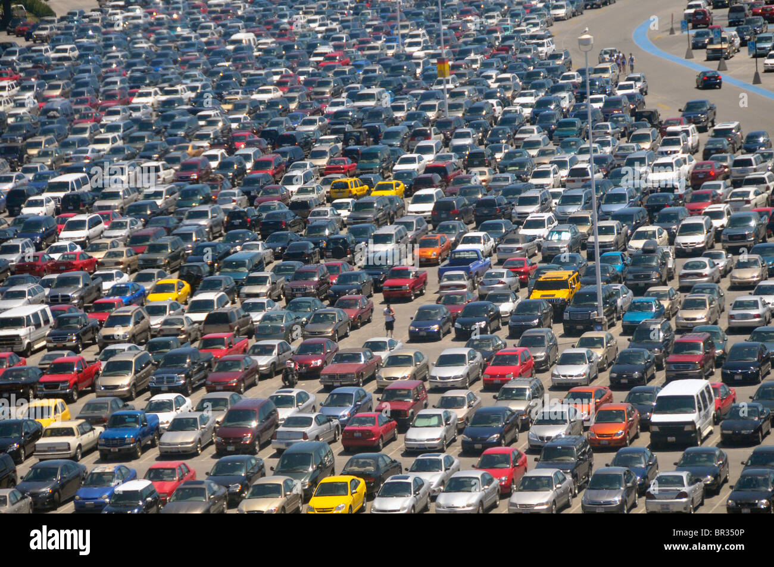
Introduction
Parking in crowded areas can be a frustrating experience for many.
The application aims to streamline the process of finding and booking parking spaces.
Users can save time and reduce stress by using the app.
Notes:
Image source: https://www.alamy.com/stock-photo-crowded-car-park-parking-lot-with-automobiles-31417254.html

Slide 4
The rapid growth in population has led to substantial traffic bottlenecks in recent transportation systems. This not only causes significant air pollution, and waste in time and energy, but also signifies the issue of the auto-park scarcity. In the age of Internet of Things (IoT) and smart city ecosystems, smart parking and relevant innovative solutions are necessary towards more sustainable future cities. Smart parking with the help of sensors embedded in cars and city infrastructures can alleviate the deadlocks in parking problems and provide the best quality of services and profit to citizens. However, several design aspects should be well investigated and analyzed before implementing such solutions.

Slide 5
we classify the smart parking systems while considering soft and hard design factors. We overview the enabling technologies and sensors which have been commonly used in the literature. We emphasize the importance of data reliability, security, privacy and other critical design factors in such systems. Emerging parking trends in the ecosystem are investigated, while focusing on data interoperability and exchange

Slide 6
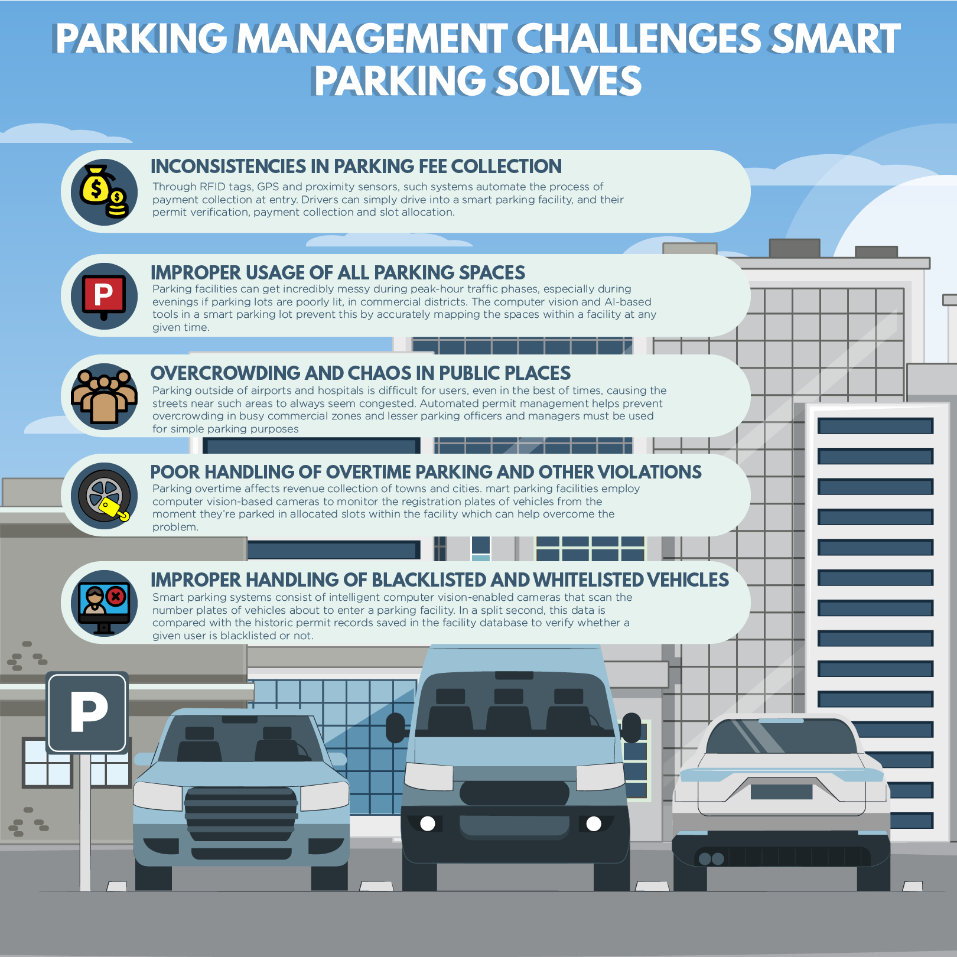
Current Challenges
Finding parking in crowded areas is time-consuming.
Lack of available parking spaces leads to frustration.
Uncertainty about parking availability can cause anxiety.
Notes:
Image source: https://www.allerin.com/blog/5-parking-permit-management-challenges-faced-by-town-managers-that-disappear-with-parking-automation

Slide 7
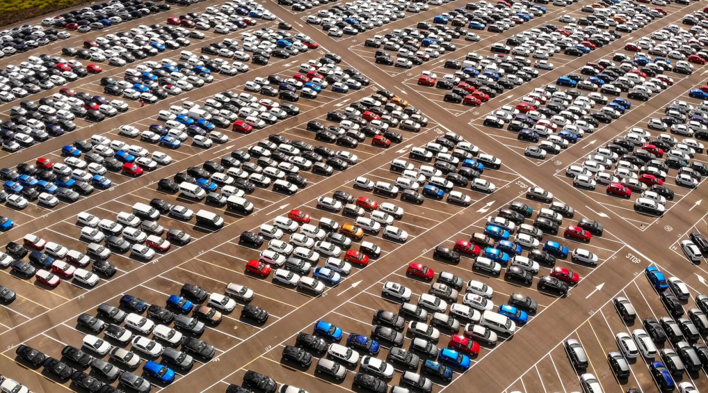
Features of the Application
Real-time parking space availability updates.
Booking parking spaces in advance.
Navigation to the selected parking spot.
Notes:
Image source: https://www.cprime.com/resources/blog/how-to-build-a-real-time-parking-availability-system/

Slide 8
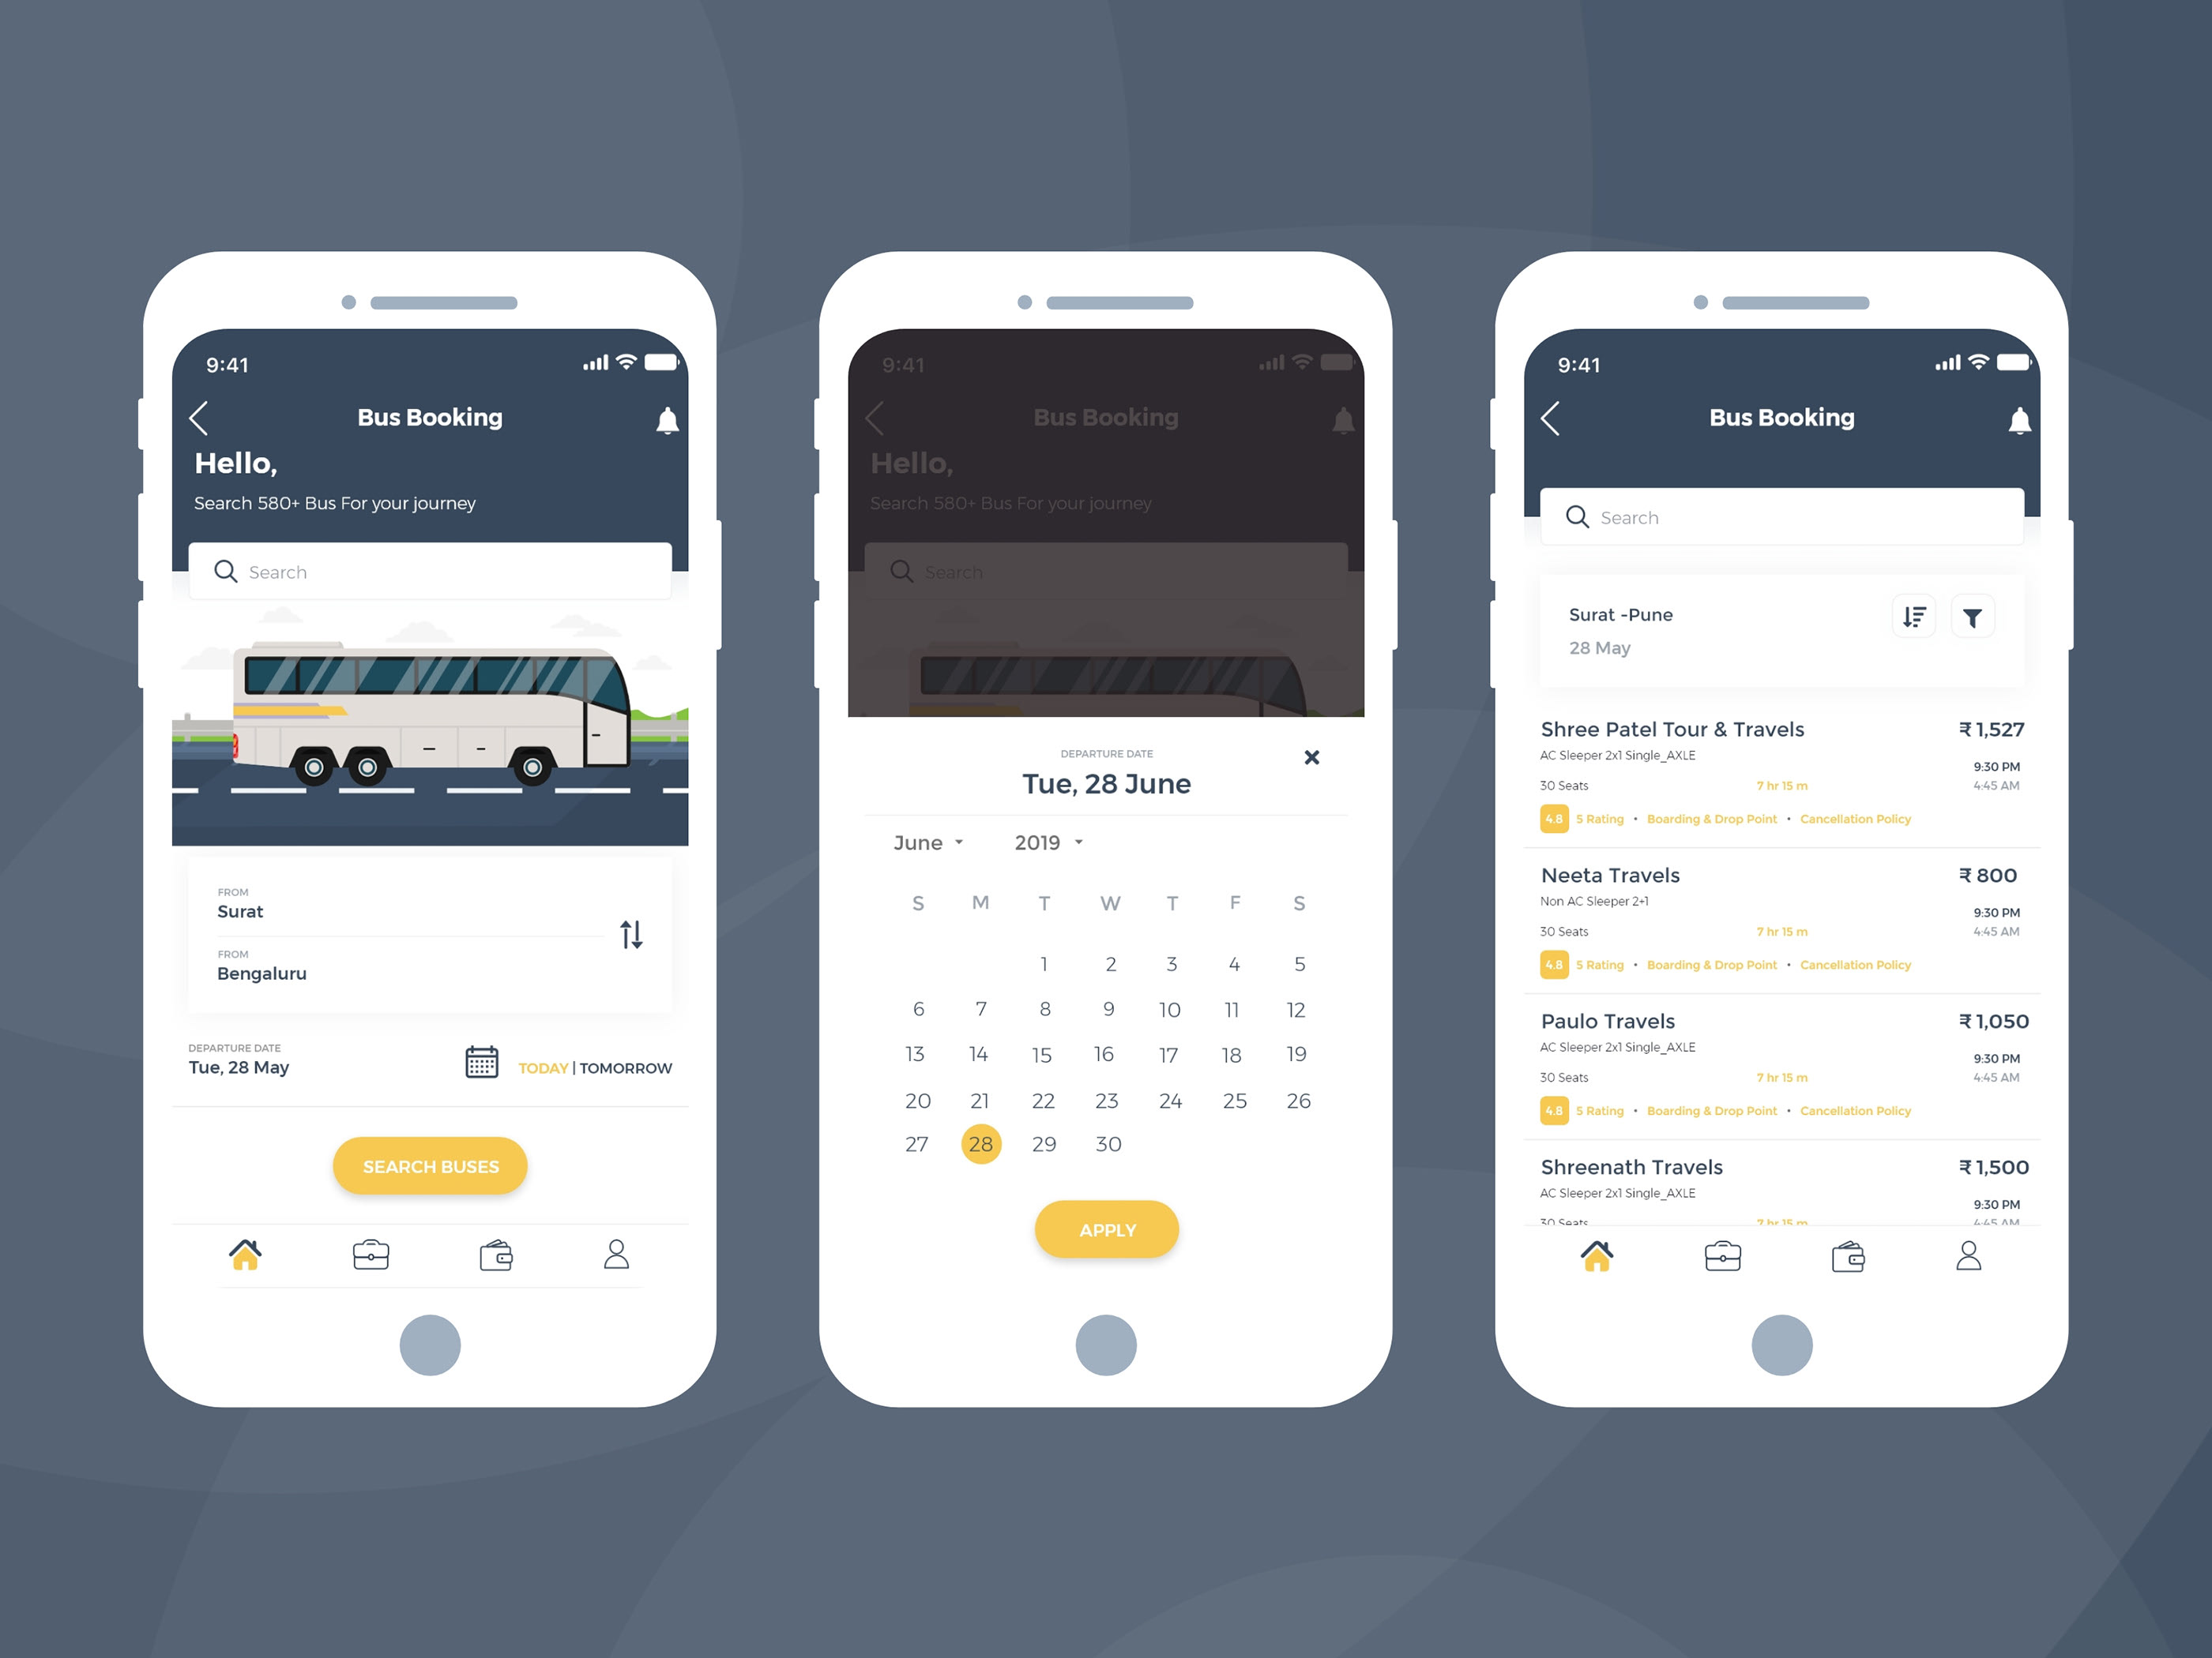
User-Friendly Interface
Intuitive design for easy navigation.
Simple booking process.
Customizable preferences for parking search.
Notes:
Image source: https://www.behance.net/gallery/84725493/Bus-Booking-App-UI-design

Slide 9
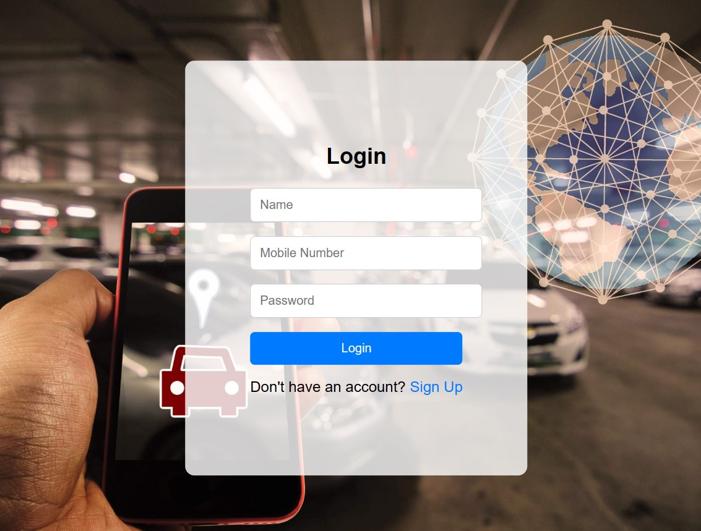

Slide 10
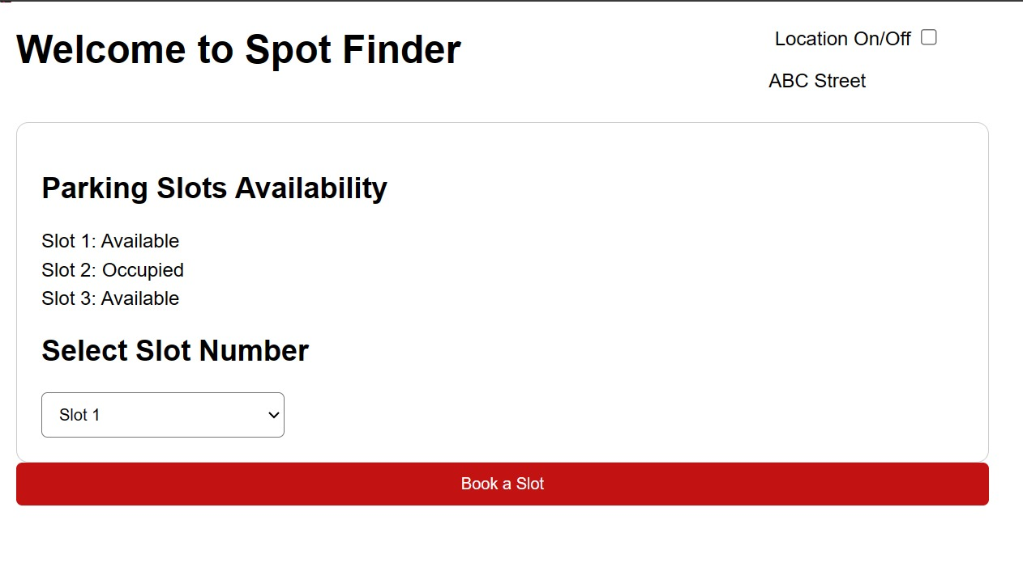

Slide 11
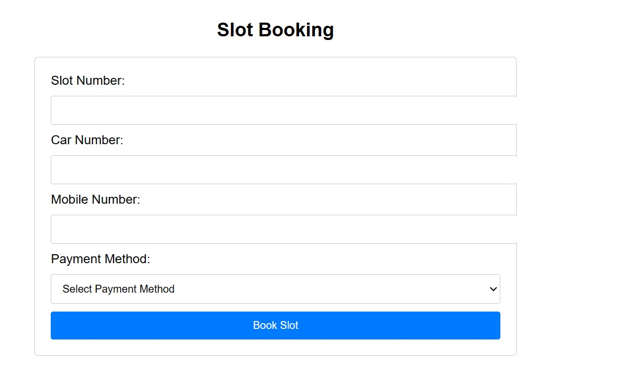

Slide 12
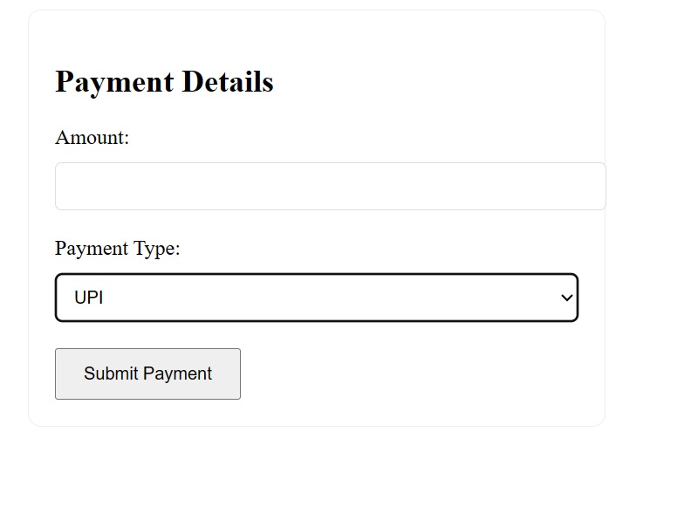

Slide 13
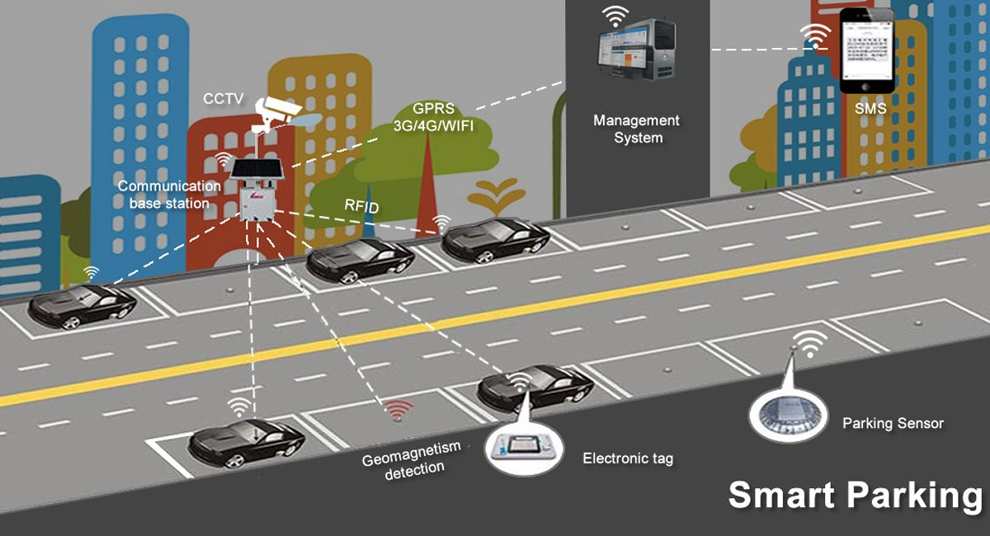
Benefits for Users
Save time searching for parking spots.
Reduce stress and frustration.
Secure parking space in advance.
Notes:
Image source: http://www.trafiksol.com/blog/save-time-space-and-fuel-with-smart-parking-solution/

Slide 14
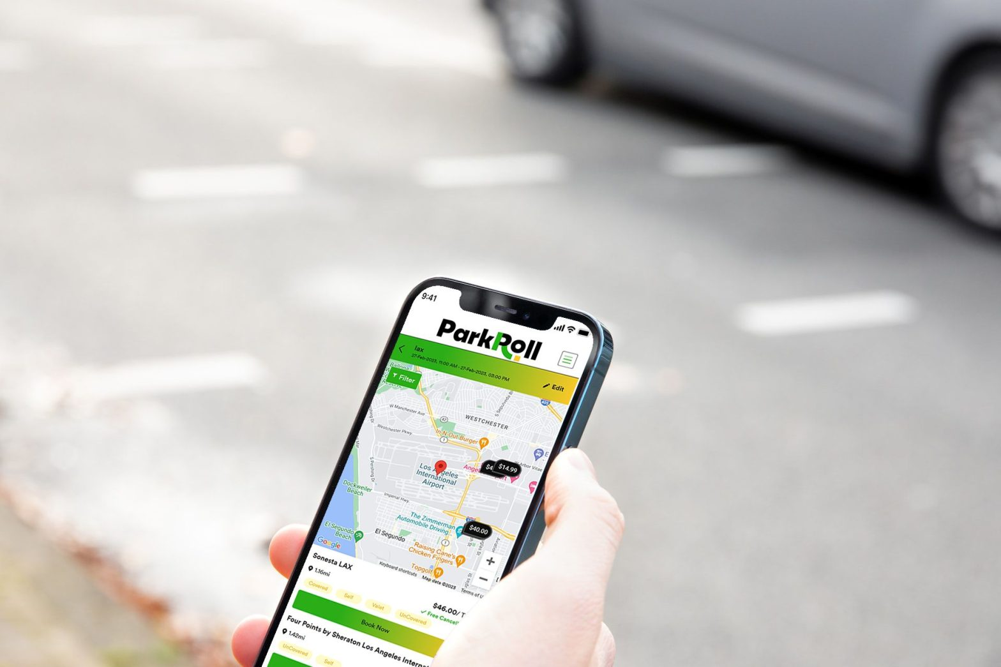
Convenience and Efficiency
Instant confirmation of booking.
Notifications for available parking spaces.
Integration with maps for easy navigation.
Notes:
Image source: https://blog.parkroll.com/the-convenience-of-booking-lax-parking-online/

Slide 15
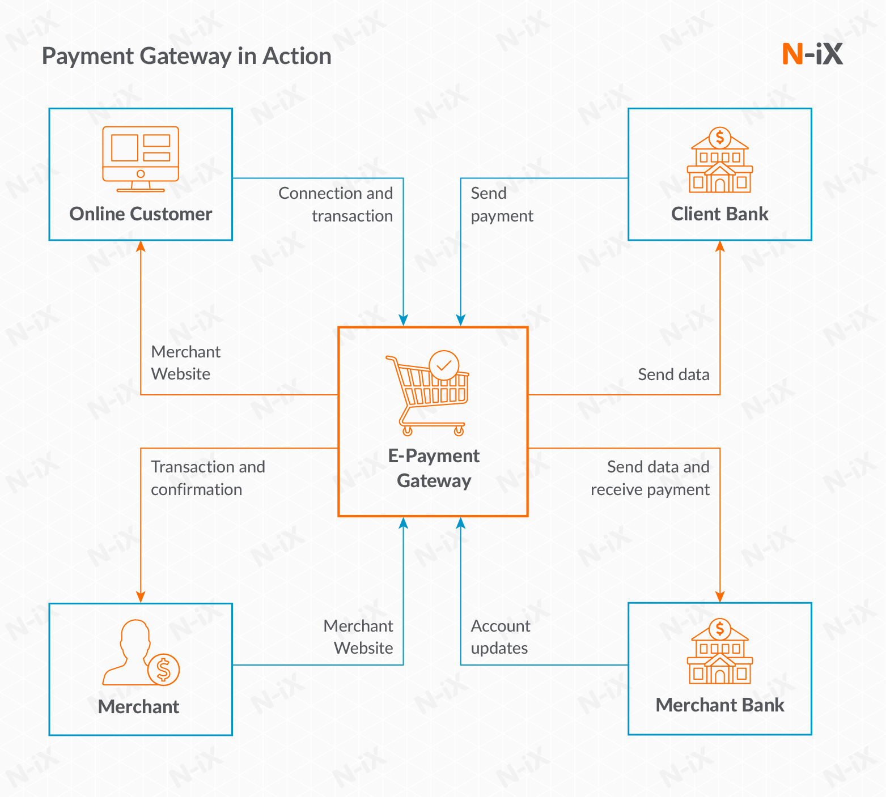
Integration with Payment Gateways
Secure payment options integrated into the app.
Cashless transactions for parking fees.
Receipts and transaction history available within the app.
Notes:
Image source: https://www.n-ix.com/secure-payment-gateway-integration/

Slide 16
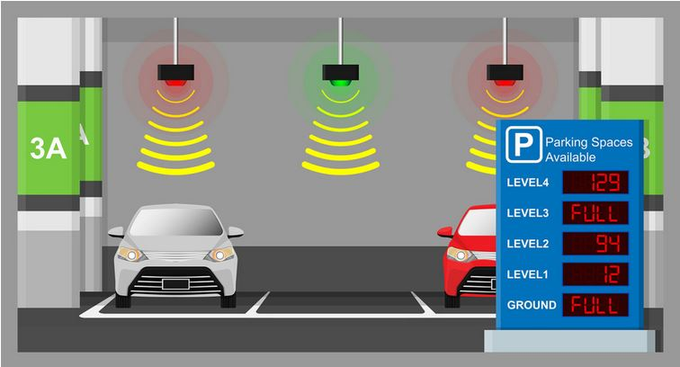
Data Analytics for Parking Trends
Analyzing parking patterns and trends.
Predicting peak hours for parking availability.
Improving user experience based on data insights.
Notes:
Image source: https://www.parking.net/parking-news/risetek-global/parking-data-analytics-helps-lot-and-garage-management

Slide 17
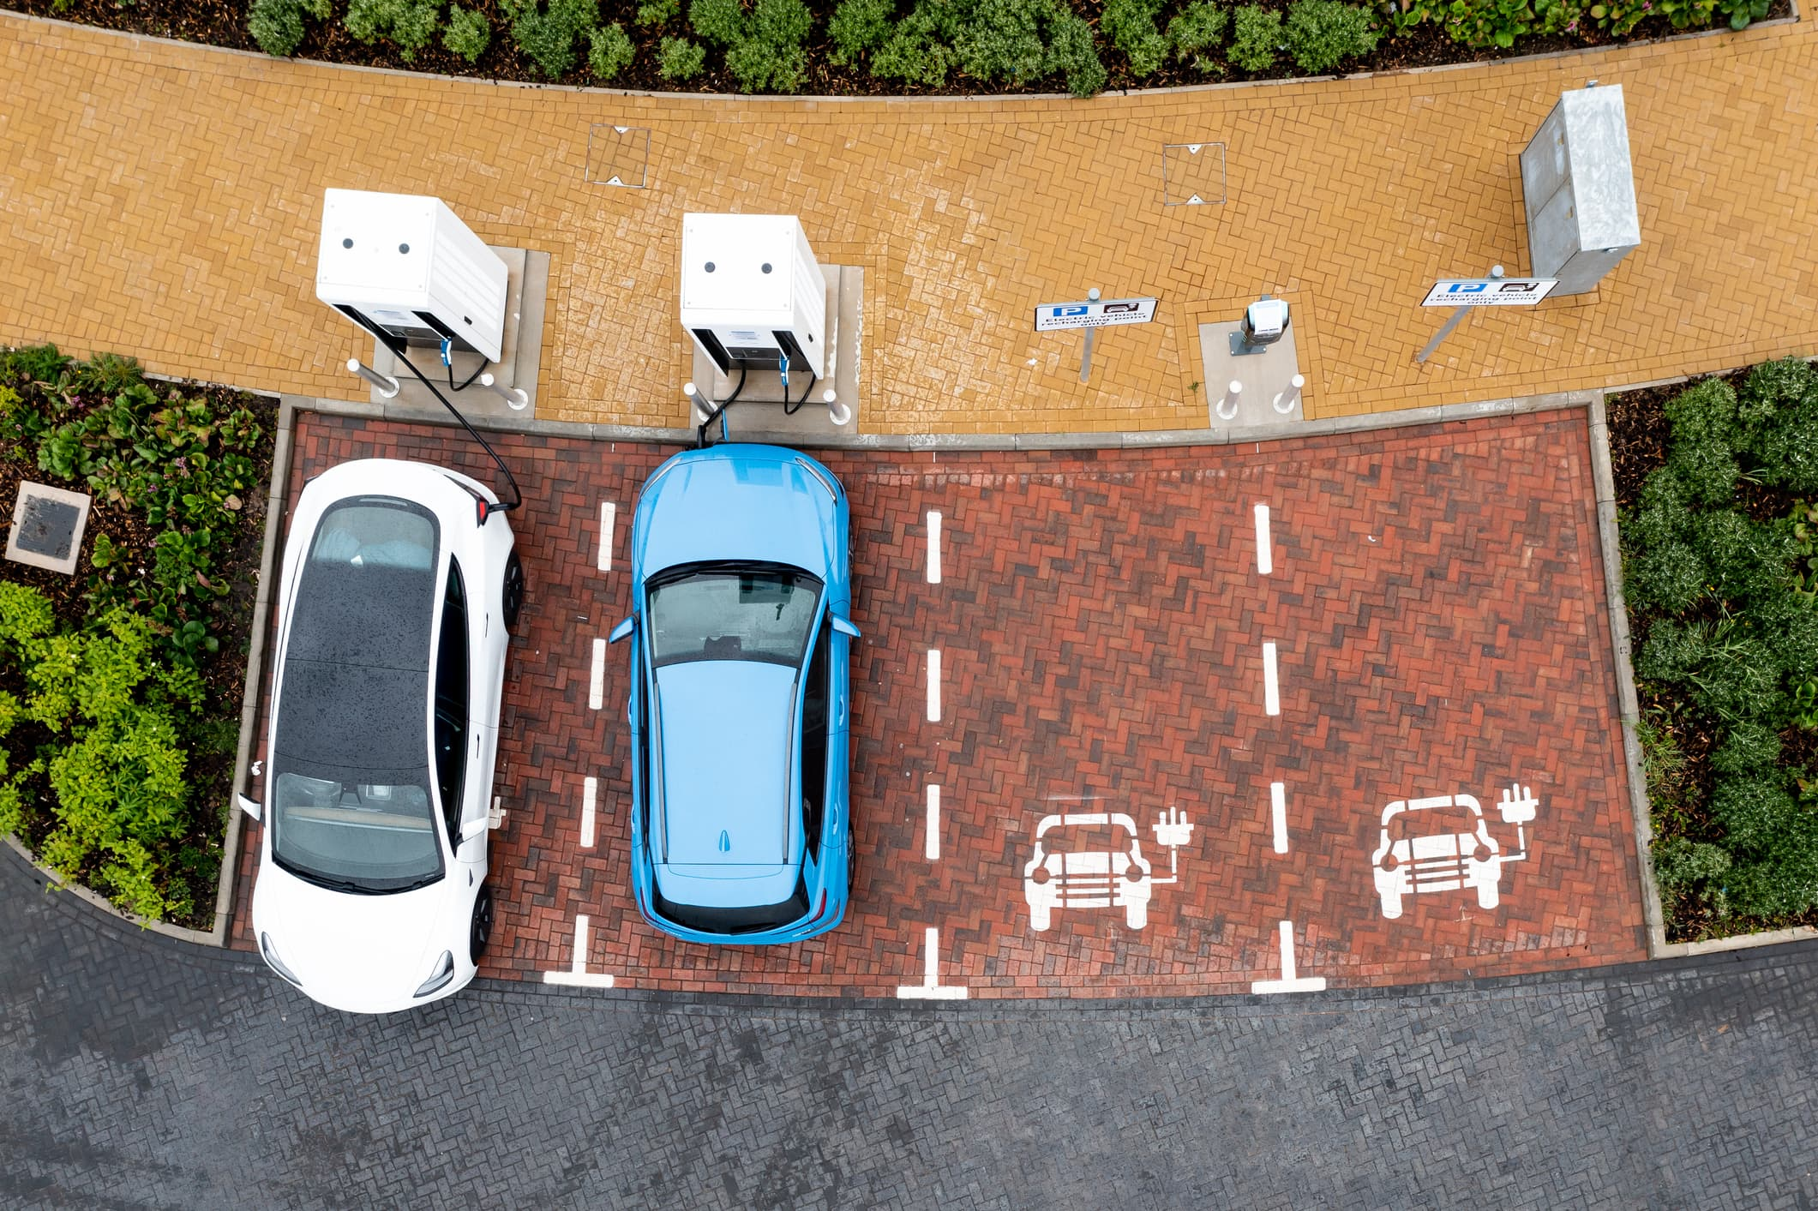
Sustainability and Green Parking
Promoting eco-friendly parking options.
Encouraging carpooling and shared parking spaces.
Rewarding users for choosing sustainable parking solutions.
Notes:
Image source: https://www.parking-mobility.org/2023/05/10/sustainable-parking-how-to-design-operate-eco-friendly-parking-facilities/

Slide 18
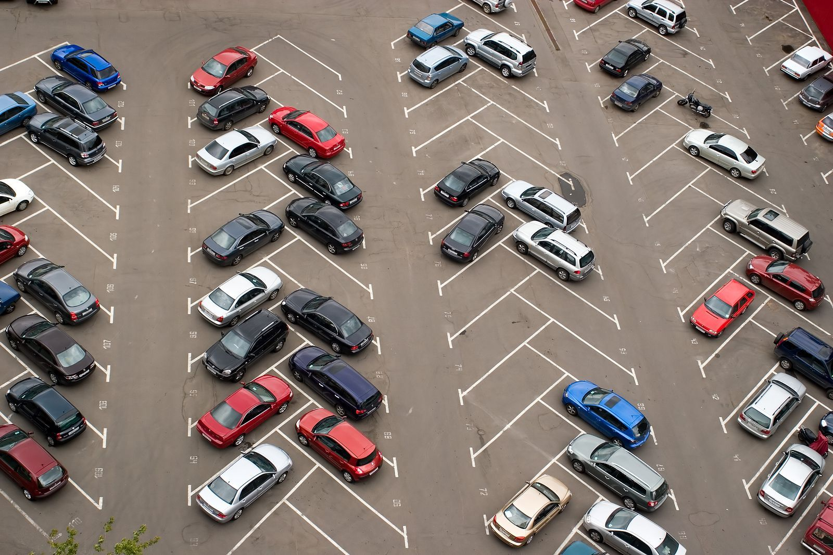
Community Engagement
Building a community of users sharing parking insights.
User reviews and ratings for parking spaces.
Social sharing features for parking experiences.
Notes:
Image source: https://www.pinterest.co.kr/pin/684054630877518680/

Slide 19
Security and Safety Measures
Ensuring secure transactions for parking bookings.
Safety guidelines for parking facilities.
Emergency support options within the app.
Notes:
Image source: https://www.swifttech.com.np/blog/secure-digital-transactions/

Slide 20

Customer Support and Feedback
24/7 customer support for user inquiries.
Feedback mechanisms for improving the app.
Regular updates based on user suggestions.
Notes:
Image source: https://www.revechat.com/blog/24x7-customer-service/

Slide 21

Marketing and Promotion Strategies
Social media campaigns to attract new users.
Referral programs for user growth.
Collaborations with local businesses for promotions.
Notes:
Image source: https://www.socialchamp.io/blog/social-media-campaign/

Slide 22

User Retention Strategies
Loyalty programs for frequent users.
Personalized recommendations for parking spots.
Gamification elements for user engagement.
Notes:
Image source: https://clevertap.com/blog/customer-loyalty-program-examples/

Slide 23
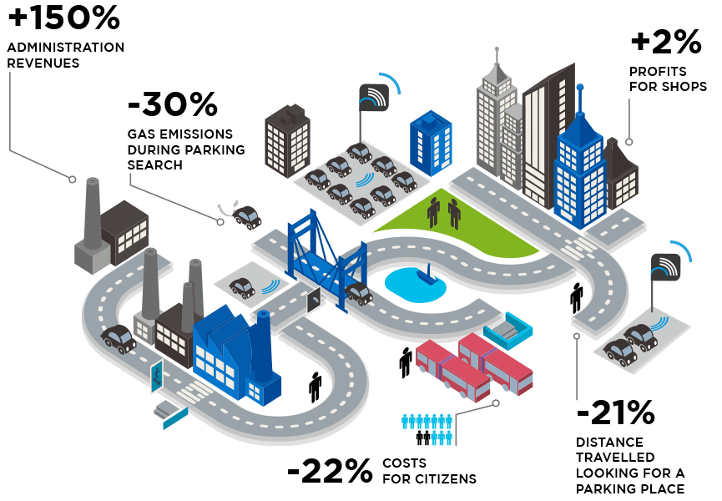
Expansion Plans and Scalability
Scaling the app to cover more cities.
Partnering with international parking facilities.
Continuous innovation for future growth.
Notes:
Image source: https://smartparkingsystems.com/en/smart-cities-cities-of-tomorrow/

Slide 24
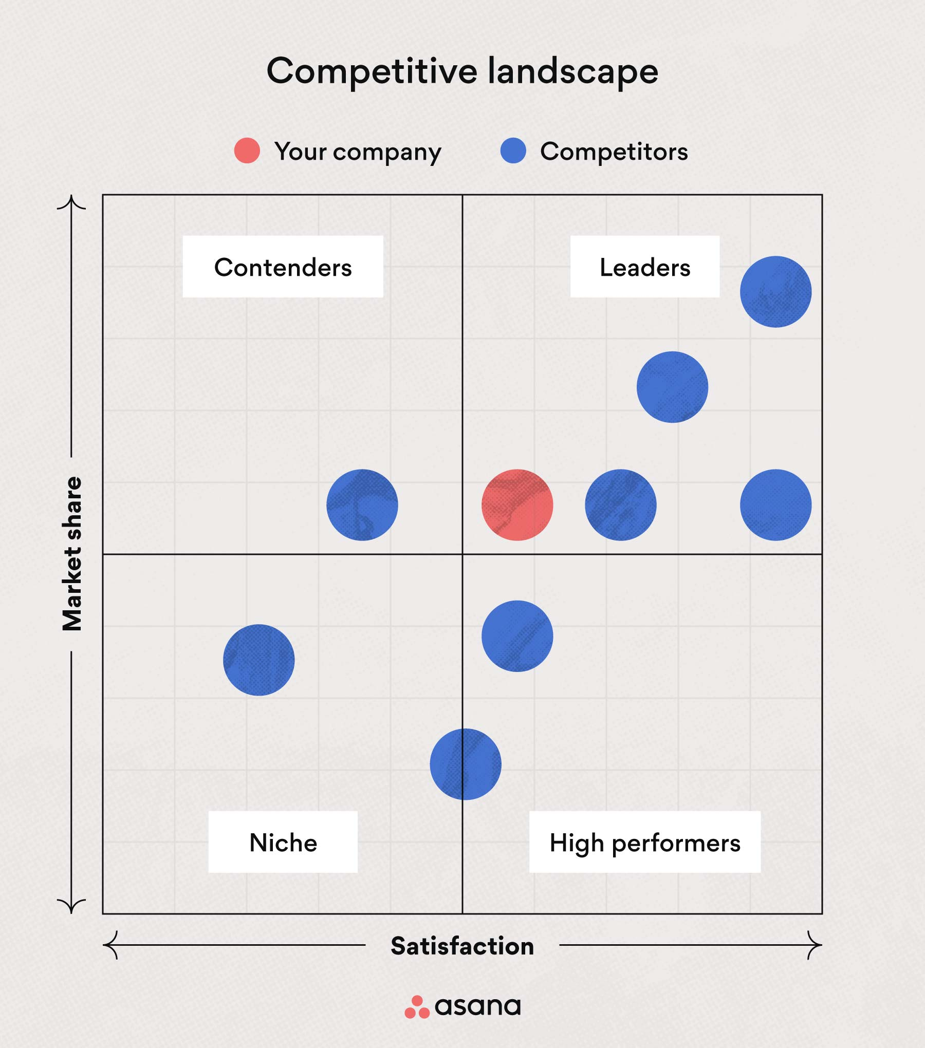
Competitive Analysis
Assessing competitors in the parking app market.
Identifying unique selling points for the app.
Differentiating features to stand out from competitors.
Notes:
Image source: https://asana.com/resources/competitive-analysis-example

Slide 25
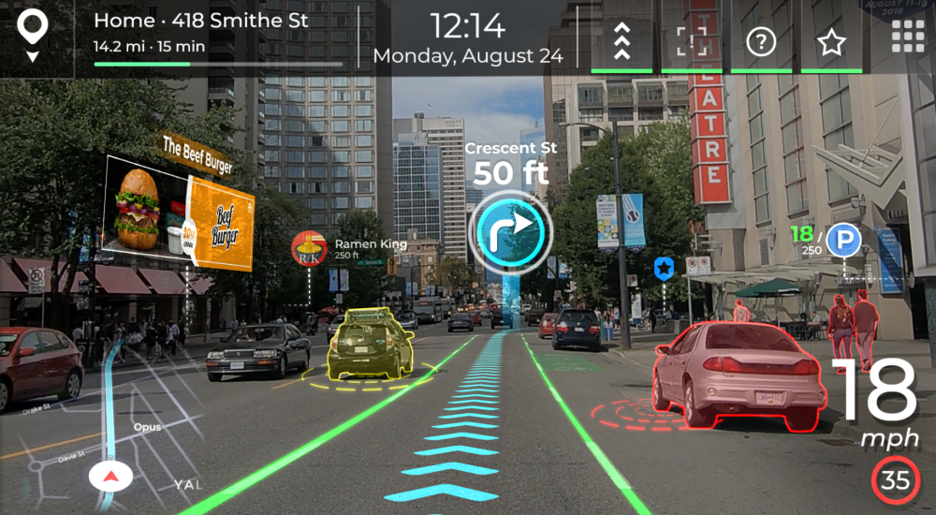
Future Developments and Enhancements
Implementing AI for predictive parking suggestions.
Augmented reality features for easier navigation.
Smart parking solutions for connected vehicles.
Notes:
Image source: https://na.panasonic.com/us/news/panasonic-collaborates-phiar-bring-real-world-ai-driven-navigation-its-automotive-solutions

Slide 26
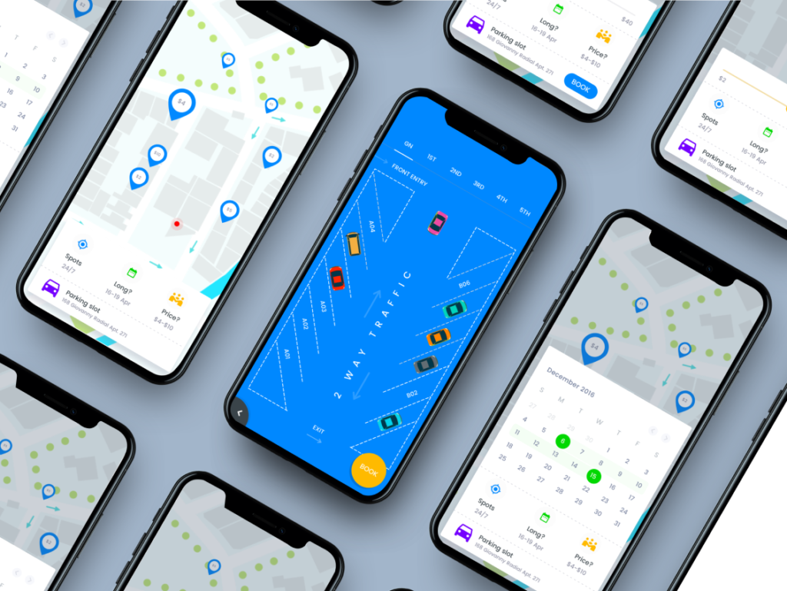
Conclusion
The app revolutionizes the parking experience in crowded areas.
Simplifying the process of finding and booking parking spaces.
Enhancing user convenience and reducing stress.
Notes:
Image source: https://amconsoft.com/5-features-for-car-parking-app-development/

Slide 27
Source code Drive Link:
https://drive.google.com/drive/folders/1AbhtiRKq4MTleHaBMCoJYtqtkybx44Hw?usp=sharing

